Slide 1


  Health Benefits
  Medical Aspects of Air Humidity

Slide 2


Why is air humidity important for our health?
Human body
Consists of 75 percent water
Regulates the functioning of the cardiovascular system and digestion
Solvent for salt and minerals
Transport for nutrients and degradation products
Each loss of water must be balanced out on a daily basis through nutrition and the intake of liquids
Too dry air promotes the dehydration of the body

Slide 3
Why is air humidity important for our health?
Lungs
An average sized human at rest inhales and exhales approx. 14,000 L of air per day
In air with RH 20%, about 800 ml of water is lost through respiration and through the skin in 8 hours
A 50 kg person loses 1 - 2% body weight while doing nothing
By the time our body volume sensors activate thirst centers, we are already clinically dehydrated

Slide 4
Dehydration
Dehydration causes:
  respiratory infections
  asthma and allergies
  fatigue, weight gain
  constipation and digestive disorders
  increased cholesterol
  joint pain and stiffness
  increased blood viscosity

Slide 5

Evolution of Buildings
Evolution of housing technology has been more important for health promotion of mankind
in history than all medical progress.
Today’s buildings are one of the most
important factors causing disease.

Slide 6
Evolution of Buildings
Prehistoric living
Area with open architecture
Unobstructed outdoor air exchange
Same conditions as outside

Slide 7

Evolution of Buildings
Modern buildings
Dense facades
Ventilated with ventilation systems
Are one of the most important factors causing disease

Slide 8
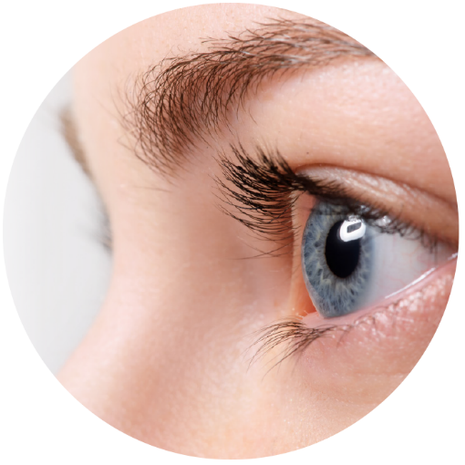
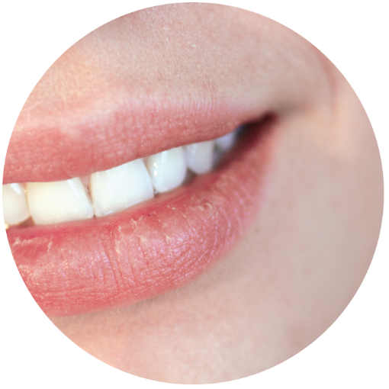


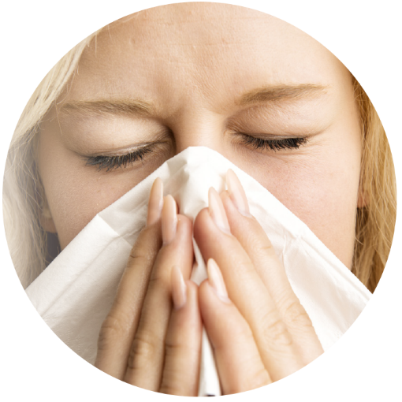
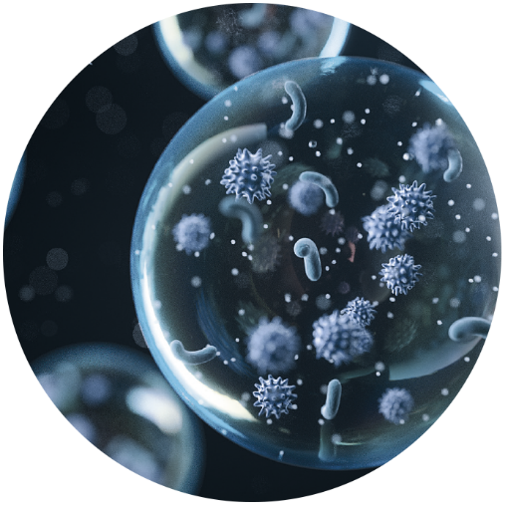
Humidity has effects on…
Eyes
Skin
Neck
Brain
Immune System
Aerosols

Slide 9
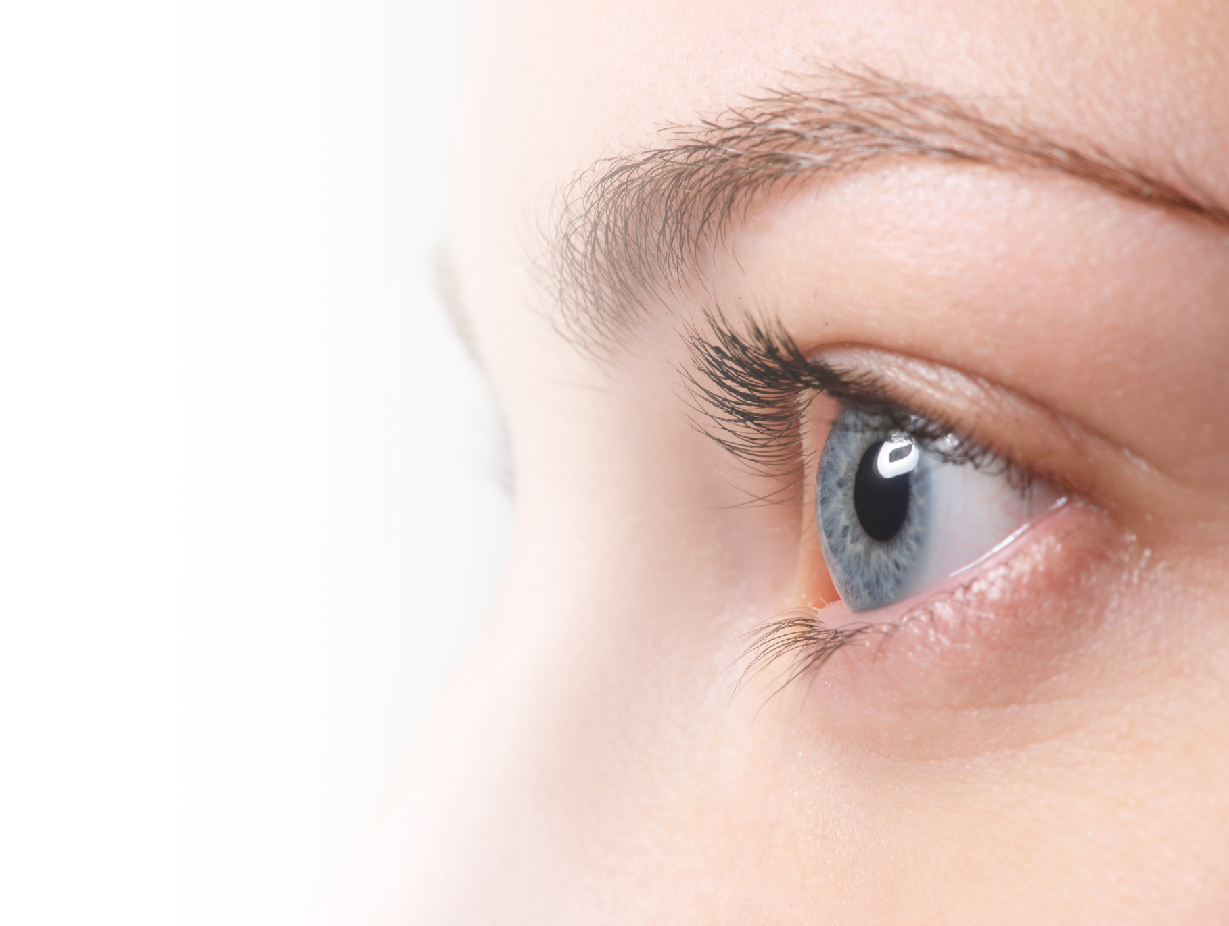
Eyes
The dry eye effect
Function: protect the surface of the eye from the impact of the surrounding environment
Excessively dry air leads to increased evaporation
Symptoms include swollen eyelids, redness, foreign body sensation, burning, and excessive sensitivity to light
  increased irritation, inflammation and
  serious damage to the eyes

Slide 10
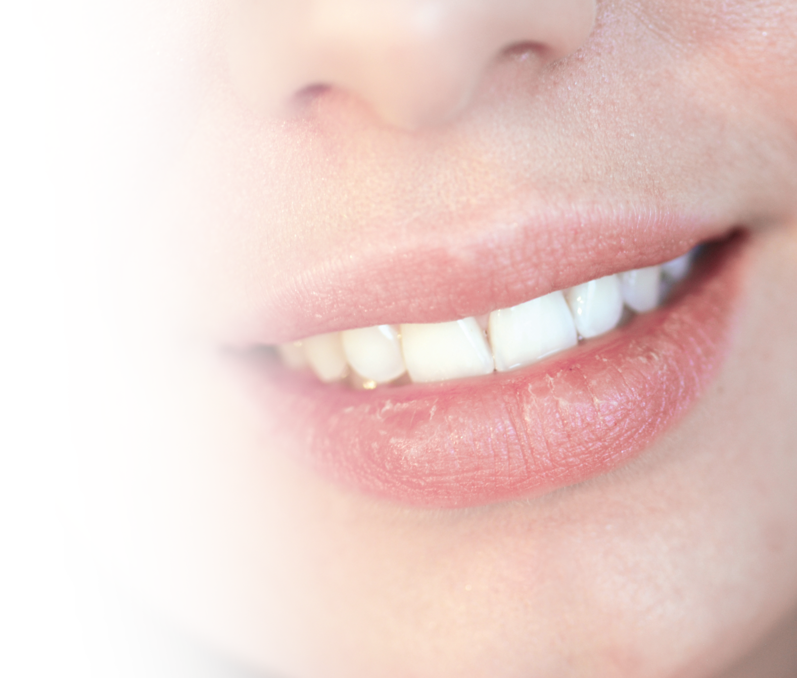
Skin
Skin
Is our largest organ with a surface of about 2m²
Protects us from cold, heat and radiation
Offers resistance to pressure and impact
Keeps germs and microorganisms at bay because of its slightly acidic pH value of 5.7
Is our primary item of clothing for heat insulation

Slide 11
Skin
Weakened skin protection
Protective function of the skin can suffer from excessively dry air in the office
Below 20 %, the skin becomes chapped and cracked
Exhibiting symptoms such as itching
Chronic skin conditions such as neurodermatitis or psoriasis

Slide 12
Skin
Our defense against
environmental
physical
chemical
microbial insults
Essential for
wound healing
immune system development

Slide 13
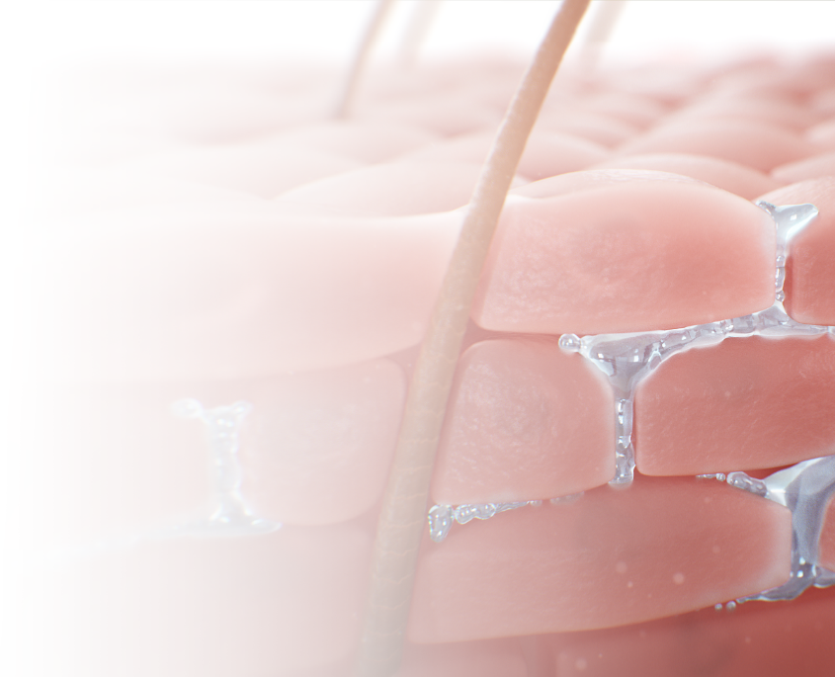
Skin
Skin structure with healthy moisture
supports breathing
is cooling when we perspire
provides an external barrier
remains elastic
Notes:
With a surface of about 2m², the skin is our largest organ. It protects us from cold, heat and radiation, offers resistance to pressure and impact, with its slightly acidic pH value of 5.7 keeps germs and microorganisms at bay, and is our primary item of clothing for heat insulation. Its structure can be seen under the microscope. There are three layers: The epidermis with a corneal layer, the dermis and the subcutaneous layer. The skin is also our largest sensory organ, supports breathing and is cooling when we perspire. All in all, the skin is multi-functional, combines water and fat tissues, provides an external barrier. If the ambient conditions are right, it remains elastic as it does so.

Slide 14
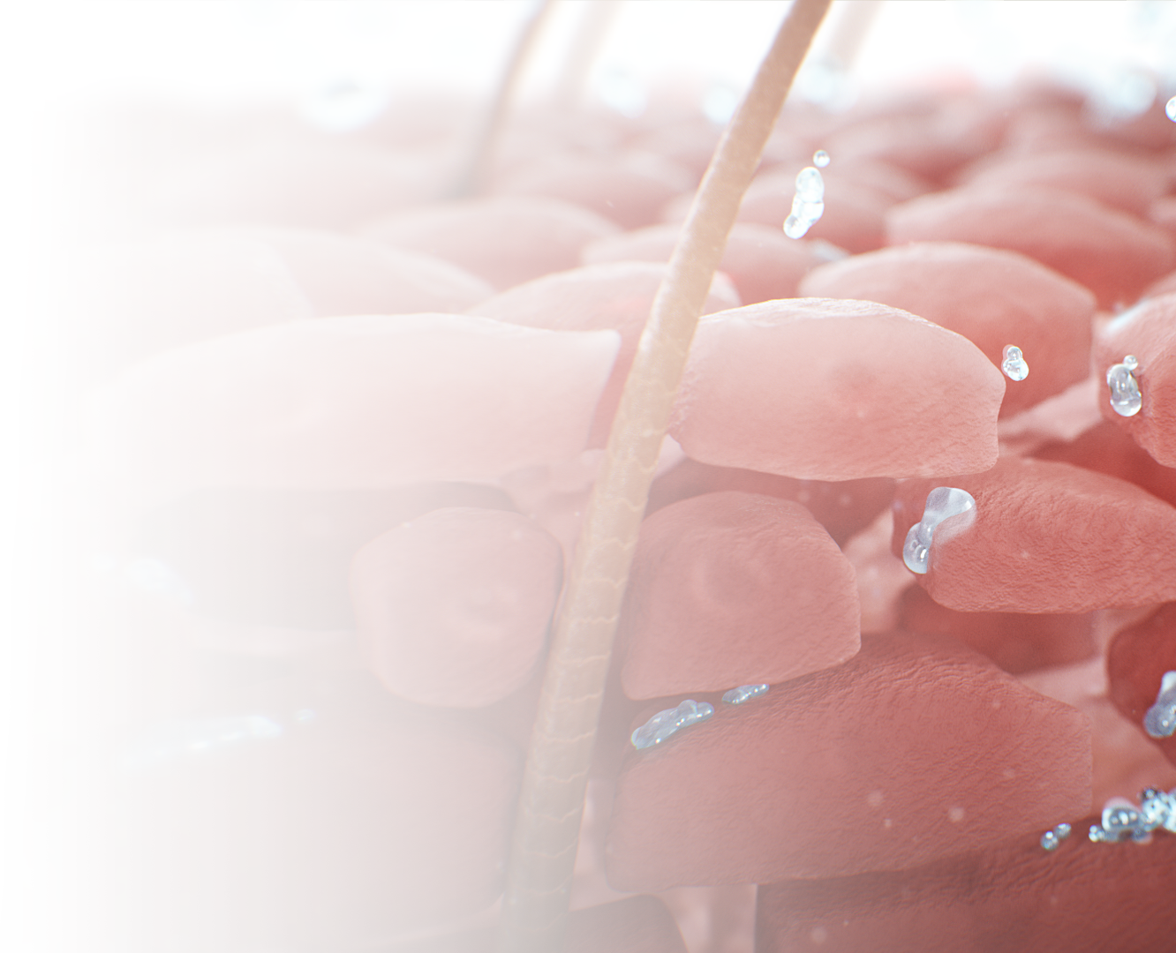
Weakened skin protection
Dry, chapped skin structure
barrier crumbles
corneal layer becomes increasingly porous
loses its protective function more and more
dangerous substances can penetrate more easily
skin irritations and inflammations
Notes:
However, if the skin loses moisture and fats, this barrier crumbles. Dry ambient air may favor this process, if the body itself can no longer obtain enough from inside to compensate. This can be the case in sick or older people especially. The same goes for infants whose skin is not yet fully formed. In these cases, the corneal layer becomes increasingly porous and loses its protective function more and more. At the same time, dangerous substances can penetrate more easily which leads to skin irritations and inflammations.

Slide 15

Neck
Hoarseness and laryngitis
Problems with the voice
Dryness of the throat and larynx, increased clearing of the throat, and hoarseness
Coughing, the need to swallow frequently and, in the worst case, voice loss

Slide 16

Brain
Decreased Brain Function
Braincells consist of 85% water
We need 20% of our blood for a sufficient oxygen supply
1% decrease of our body weight from water losses diminishes our:
    ability to think
    short-term memory
    concentration
    reaction times
    visual-motor tracking

Slide 17
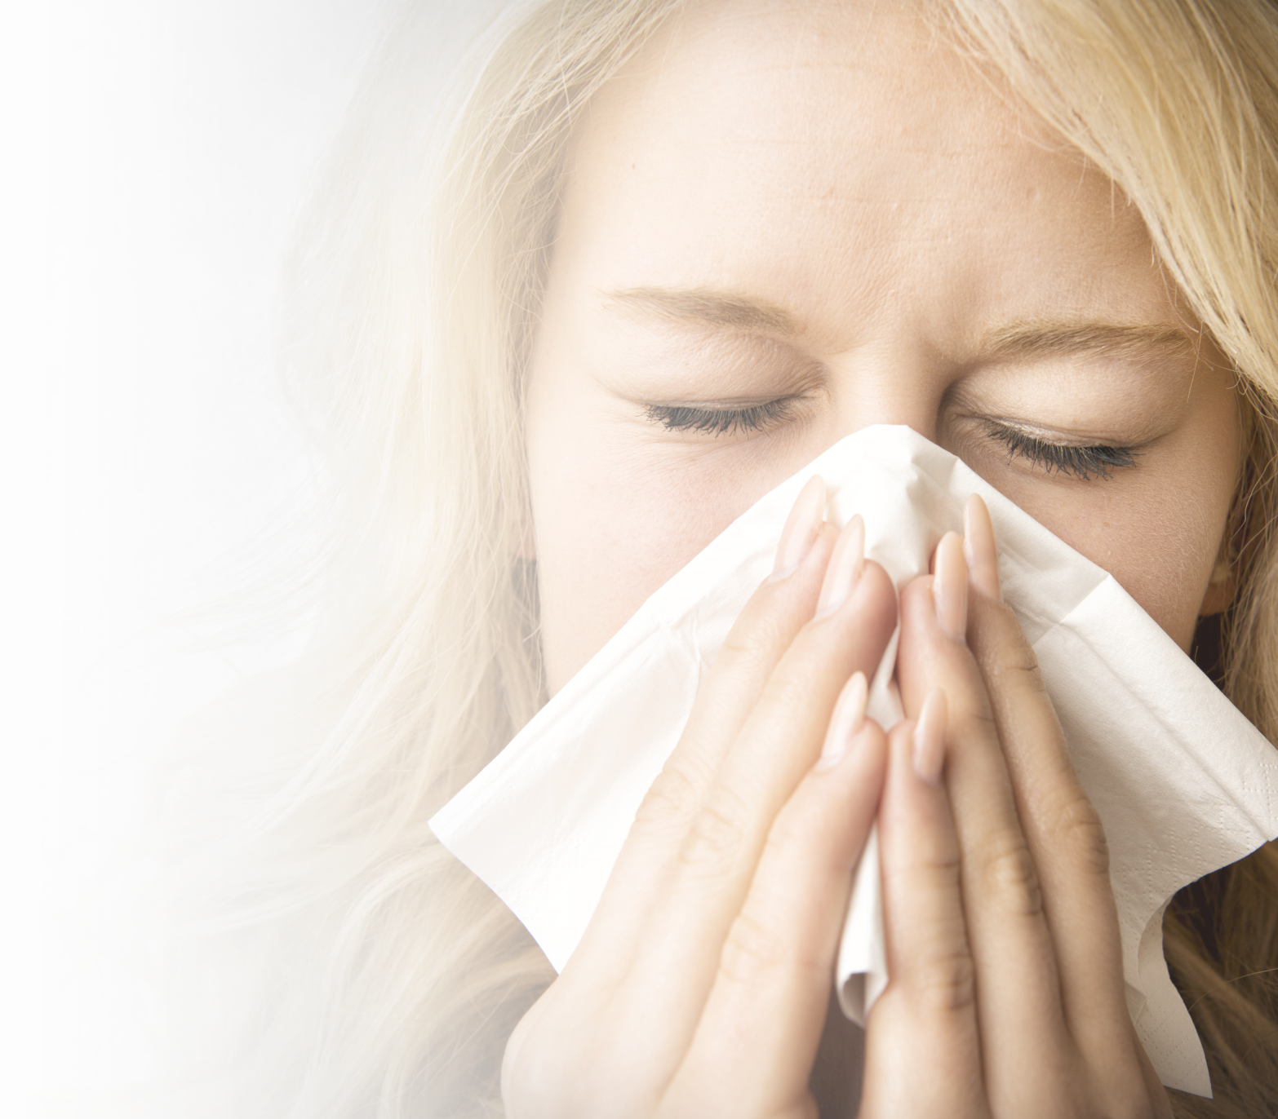
Immune System
Immune defense
Protects a healthy body from the infiltration of viruses, bacteria and other undesirable particles or germs
Ambient air sweeps into the lungs and into the alveoli
The entire way there is coated with mucous membranes, which excrete a fluid on a continuous basis

Slide 18
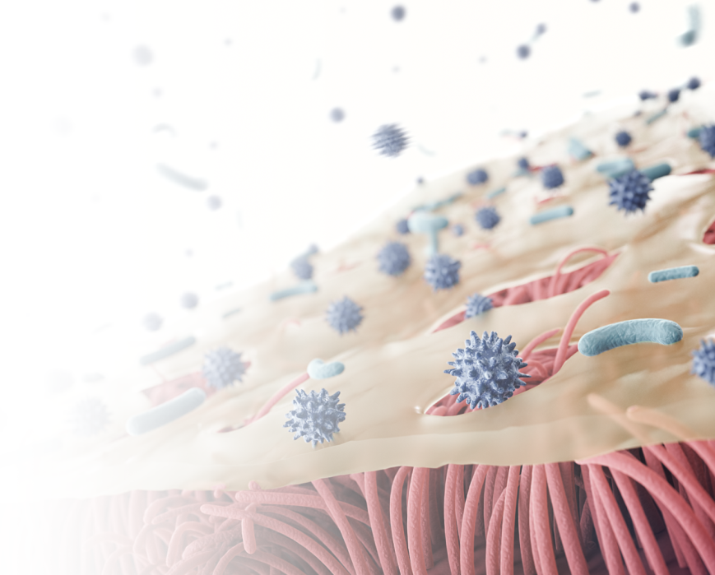
Immune System
Dry, immunodeficient nasal mucous membrane
Dry air compromises the functioning of the respiratory epithelium
Mucous no longer obtains enough water and moisture
mucous thickens, no longer runs off and breaks down
self-cleaning effect only works inadequately

Slide 19
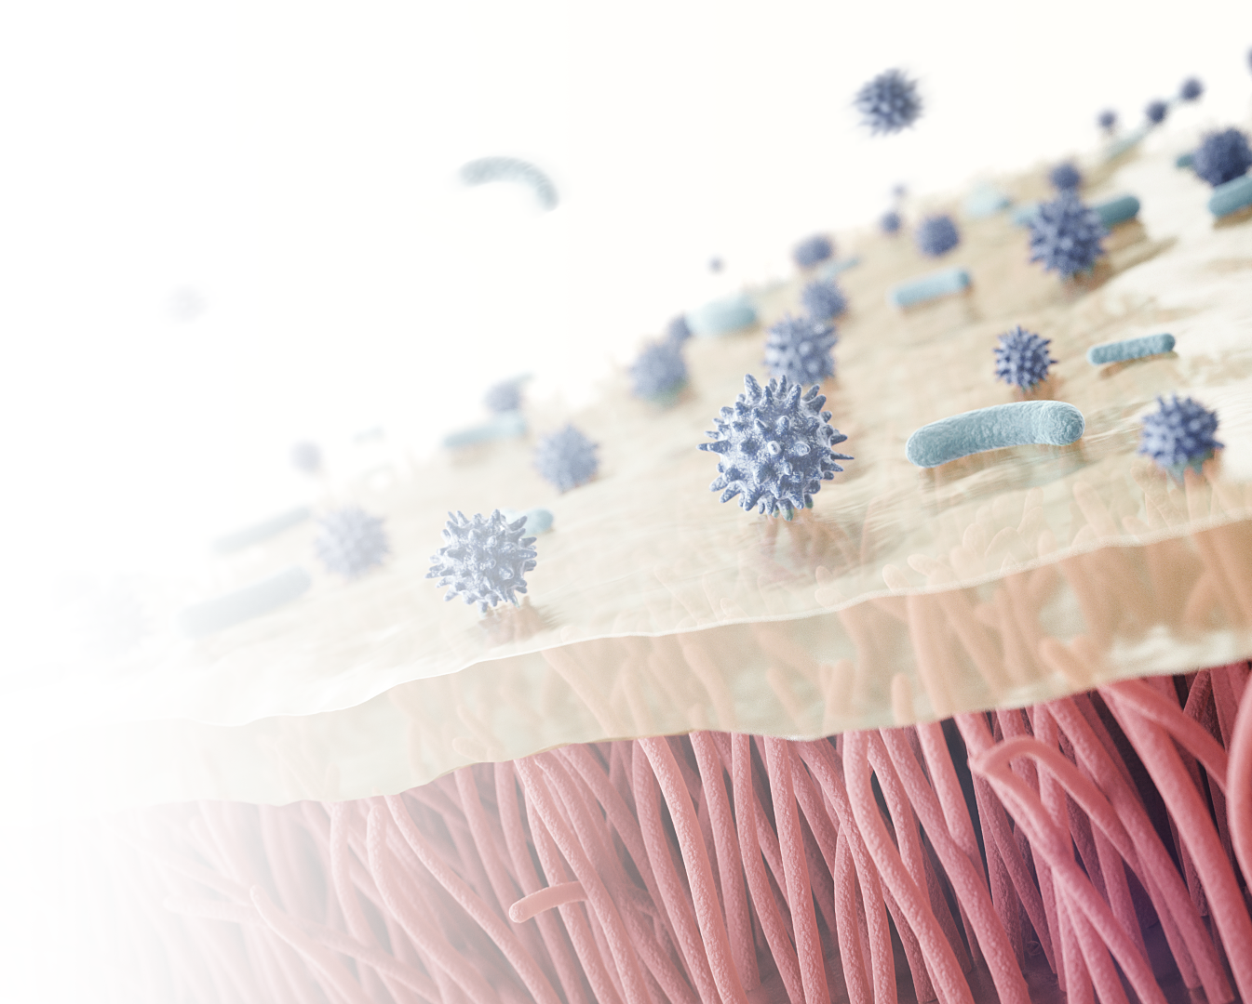
Immune System
Viscous, functional nasal mucous membrane
Mucous membranes and cilia are constantly in motion
impurities and disease-causing agents inhaled in the air we breathe are blended with mucous
then carried away before an infection can occur

Slide 20
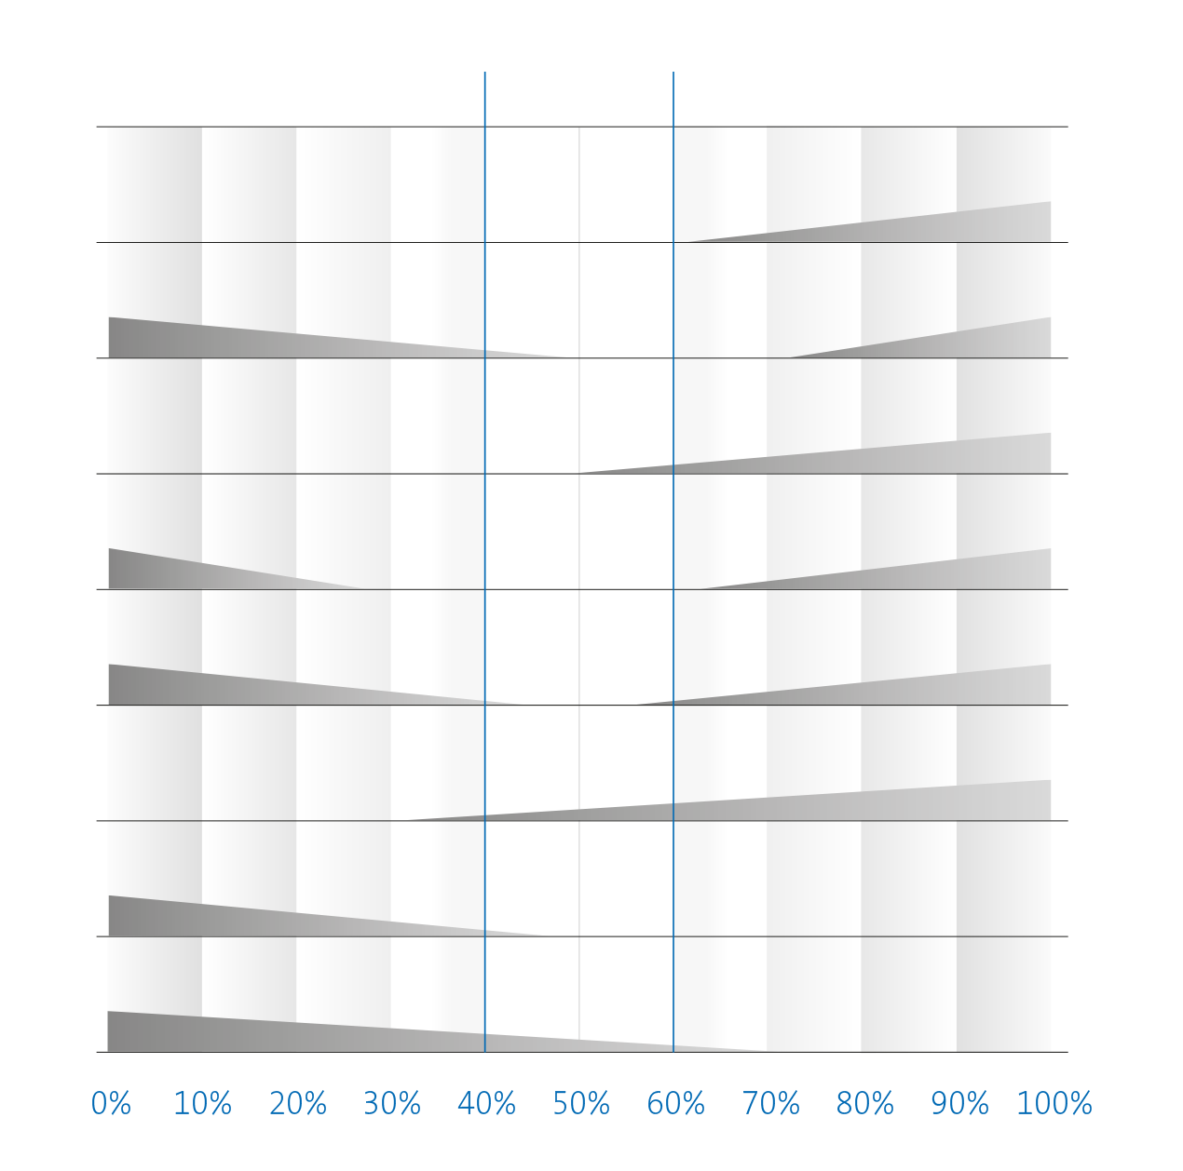
Scofield-Diagram
40 – 60 % RH
Fungi
Viruses
Mites
Bacteria
Allergic rhinitis
Chemical reactions
Respiratory tract infection
Ozone
Relative humidity

Slide 21

Danger of germs through aerosols
Under 20% rel. humidity:
Tiny droplets dry up
Loaded with flu or cold viruses
Shrink to sizes of up to 0.5 µm
Salt concentration increases so much that a veritable crust forms around
Capacity of the germs to survive indoors and the ability of the droplet to float are maximized

Slide 22

Danger of germs through aerosols
Between 40 and 60% rel. humidity:
Prevents droplets from drying out and forming a salt casing
in a highly-concentrated saline solution they become inactive within a few minutes

Slide 23

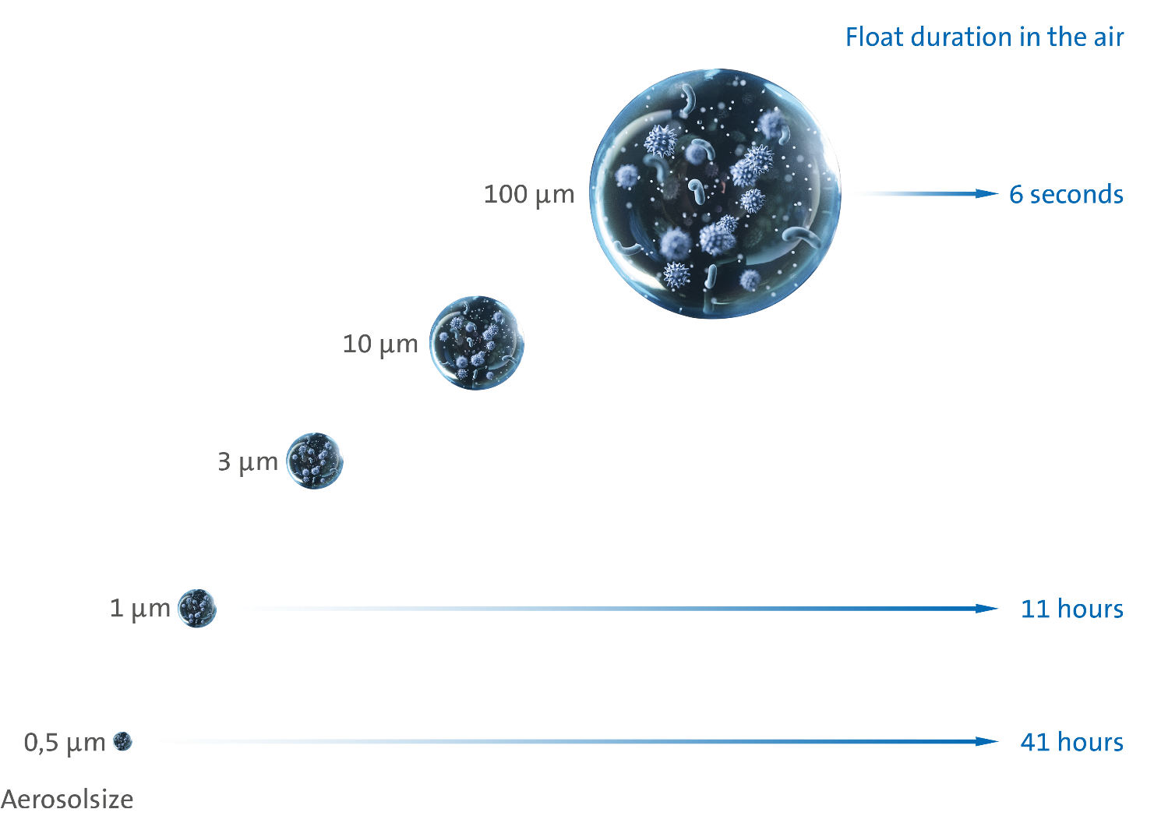
Float Duration

Slide 24
Float Duration
Experiment: University of West Virginia in Morgantown
Role of relative humidity in the aerosol transmission of influenza
simulated examination room containing coughing and breathing manikins
First doll coughs five times a minute with 100 million influenza viruses each
Second doll has bioaerosol sampler on its mouth
At constant temperature, the RH was varied from 7–73%
infectivity was assessed by the viral plaque assay
Notes:
Background
The role of relative humidity in the aerosol transmission of influenza was examined in a simulated examination room containing coughing and breathing manikins.
Methods
Nebulized influenza was coughed into the examination room and Bioaerosol samplers collected size-fractionated aerosols (<1 µM, 1–4 µM, and >4 µM aerodynamic diameters) adjacent to the breathing manikin’s mouth and also at other locations within the room. At constant temperature, the RH was varied from 7–73% and infectivity was assessed by the viral plaque assay.

Slide 25
Float Duration
Results after 60 minutes
At relative humidity ≤ 23% → total virus retained 70.6–77.3% infectivity
At relative humidity ≥ 43% → total virus retained 14.6–22.2% infectivity
Analysis of the individual aerosol fractions
similar loss in infectivity among the fractions
Time interval analysis
most of the loss in infectivity within each aerosol fraction occurred 0–15 minutes after coughing
Notes:
Results
Total virus collected for 60 minutes retained 70.6–77.3% infectivity at relative humidity ≤23% but only 14.6–22.2% at relative humidity ≥43%. Analysis of the individual aerosol fractions showed a similar loss in infectivity among the fractions. Time interval analysis showed that most of the loss in infectivity within each aerosol fraction occurred 0–15 minutes after coughing. Thereafter, losses in infectivity continued up to 5 hours after coughing, however, the rate of decline at 45% relative humidity was not statistically different than that at 20% regardless of the aerosol fraction analyzed.

Slide 26
Float Duration
Conclusion
At low relative humidity, influenza retains maximal infectivity
Inactivation of the virus at higher relative humidity occurs rapidly after coughing
Maintaining indoor relative humidity >40% will significantly reduce the infectivity of aerosolized virus
Notes:
Conclusion
At low relative humidity, influenza retains maximal infectivity and inactivation of the virus at higher relative humidity occurs rapidly after coughing. Although virus carried on aerosol particles <4 µM have the potential for remaining suspended in air currents longer and traveling further distances than those on larger particles, their rapid inactivation at high humidity tempers this concern. Maintaining indoor relative humidity >40% will significantly reduce the infectivity of aerosolized virus.

Slide 27
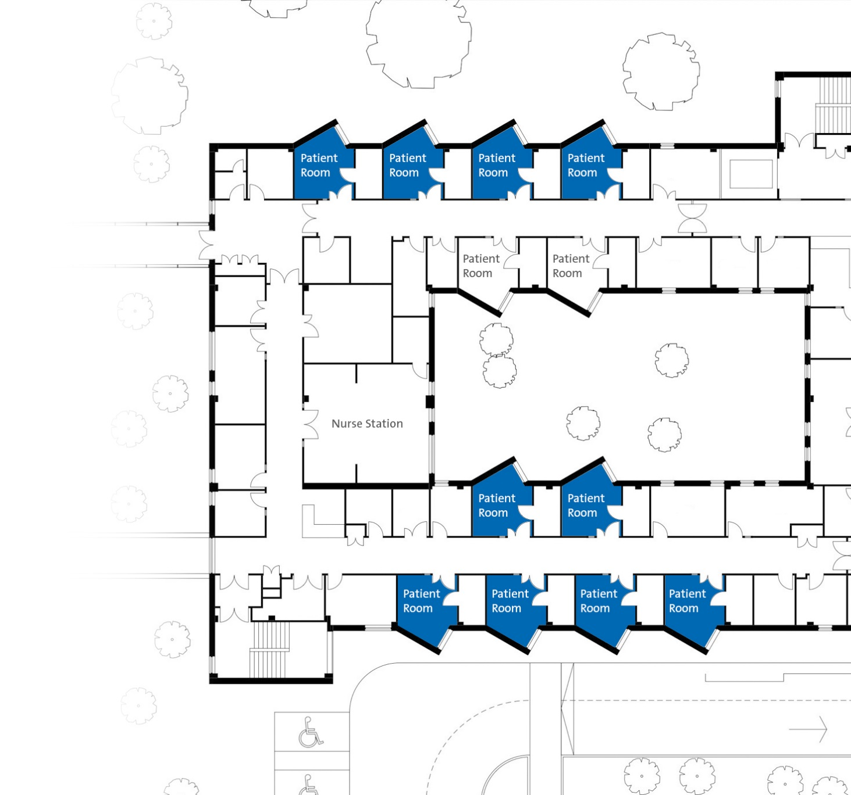
A study on patient infections and indoor air
Room environment also influences patient infection rates
Microbiome project in a new hospital
1.2 million square feet
240 single-occupancy inpatient rooms
52 ICU beds. 28 operating suites
A three layer study over 13 months
10 monitored patient rooms

Slide 28

A study on patient infections and indoor air
Indoor RH
Healthcare-Associated
Infections

Slide 29
A study on patient infections and indoor air
Conclusion
At low relative humidity, Healthcare-Associated Infections increase
Higher spread at low humidity
Humidification in hospitals in necessary to protect against HAIs

Slide 30

As you can see, air humidity has a huge effect on our bodies, especially on eyes, skin, neck, brain
and our immune system.
Humidity also influences float duration and infectivity of aerosols.
Please pay attention to the correct humidity
in order to protect your health
and that of your family!

Slide 31


  Thank you for your attention!
  Condair Group AG
  Talstraße 35-37
  8808 Pfäffikon
  SWITZERLAND

